Slide 1

Smoker Status Prediction using Bio-Signals

Slide 2
Objectives
Preprocessing
CONTENT
Feature Selection
Model developing
Model Comparison

Slide 3

Objectives

Slide 4
Technical Objectives
To develop a predictive model that accurately identifies individuals' smoking status based on comprehensive health data
1: Data Understanding and Preparation
2: Model Benchmarking with Logistic Regression
3: Complexity and Accuracy with Random Forest
4: Advanced Predictions with XGBoost
5: Rigorous Model Evaluation

Slide 5
Business Objectives
1: Targeted Health Interventions: Develop a predictive model to identify smokers within the population, enabling targeted health interventions and support programs designed to reduce smoking rates and associated health risks.
2: Health Insurance Risk Assessment: Utilize the model to assess the risk profile of insurance applicants based on their smoking status, informing policy pricing and risk management strategies.
3: Public Health Policy Support: Provide data-driven insights to support public health policies and campaigns focused on smoking cessation, leveraging the predictive model to understand the prevalence of smoking across different demographics.
4: Personalized Patient Care in Smoking Cessation: Apply the model to healthcare settings to identify patients who are smokers, tailoring smoking cessation programs to individuals based on their health profiles and risk factors.

Slide 6
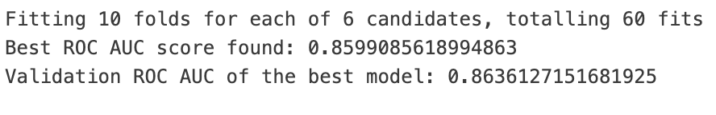
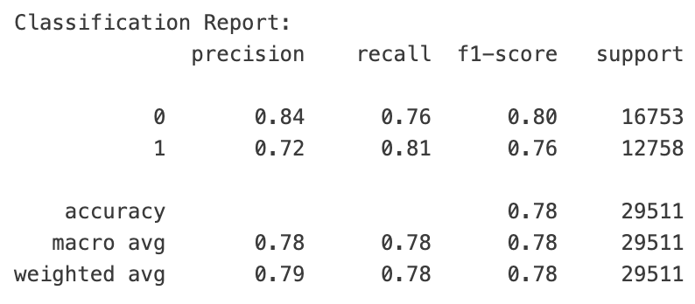
Results
Key features selected:
Height, weight – gender related
Haemoglobin – smoking reduces the oxygen content in the blood
GTP – smoking can damage the liver, leading to increased release of GTP
Triglyceride – smoking affects fat metabolism
Serum creatine – smoking can damage the kidneys, affecting their filtration function and reducing serum creatinine excretion
Age – as individuals age, the effects of smoking on health may become more apparent
HDL – smoking affects lipid metabolism
LDL – smoking affects lipid metabolism
ALT – smoking can damage the liver
Best result generated by XGBoost.

Slide 7
Preprocessing

Slide 8
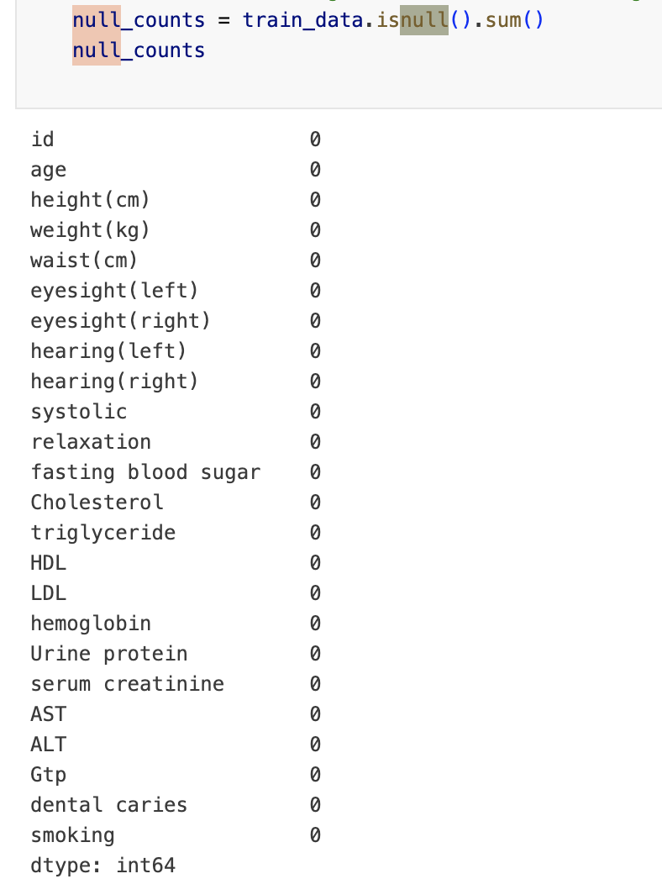
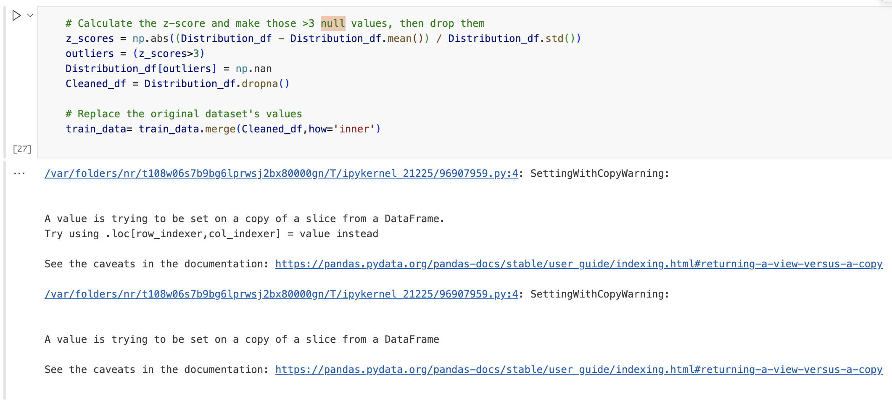
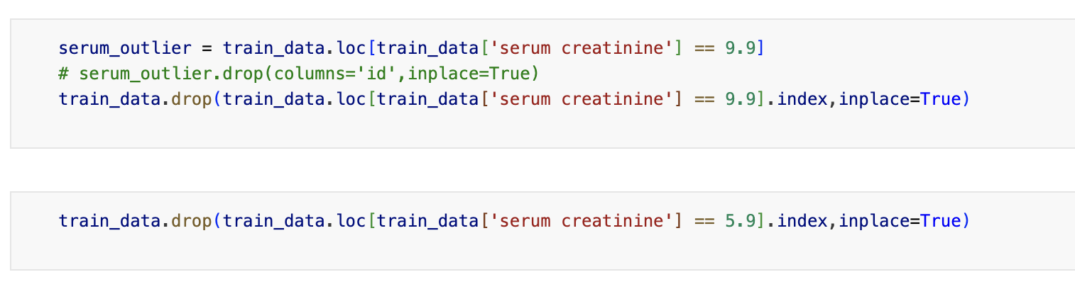
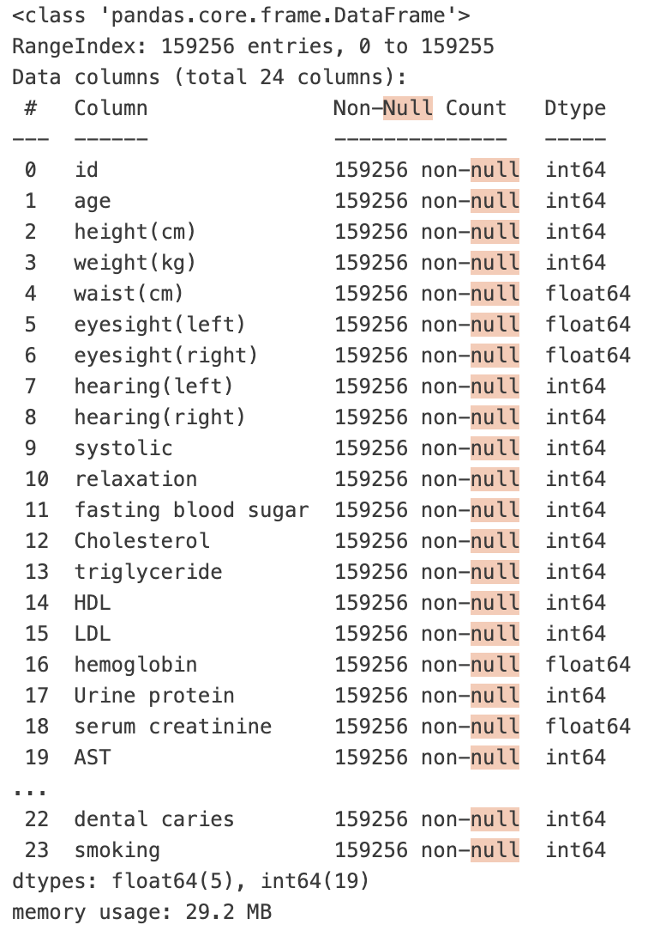
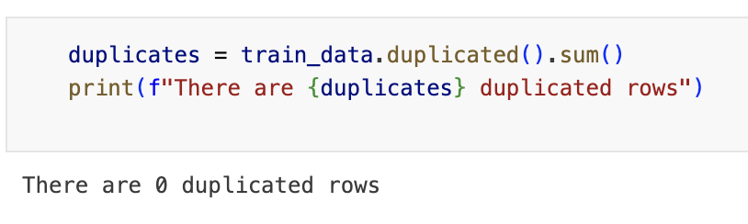
Data cleaning
Data Quality
Eyesight – Research paper
Numerical – Z-score
Serum creatinine – discarded 1 row
No missing data
Null Values
Outliers
No duplicates
Duplicates
Data types
Data types correct.

Slide 9
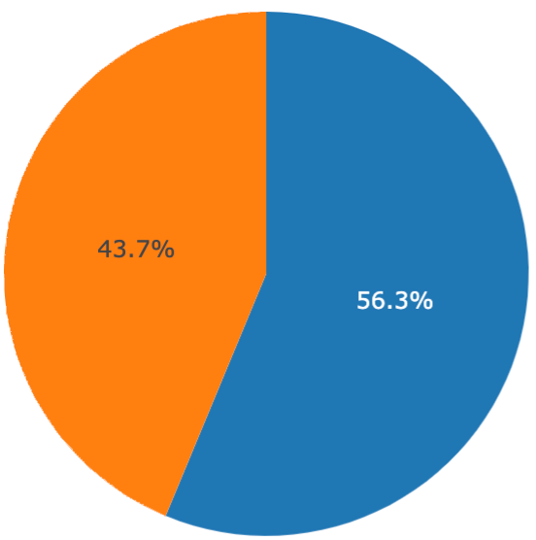
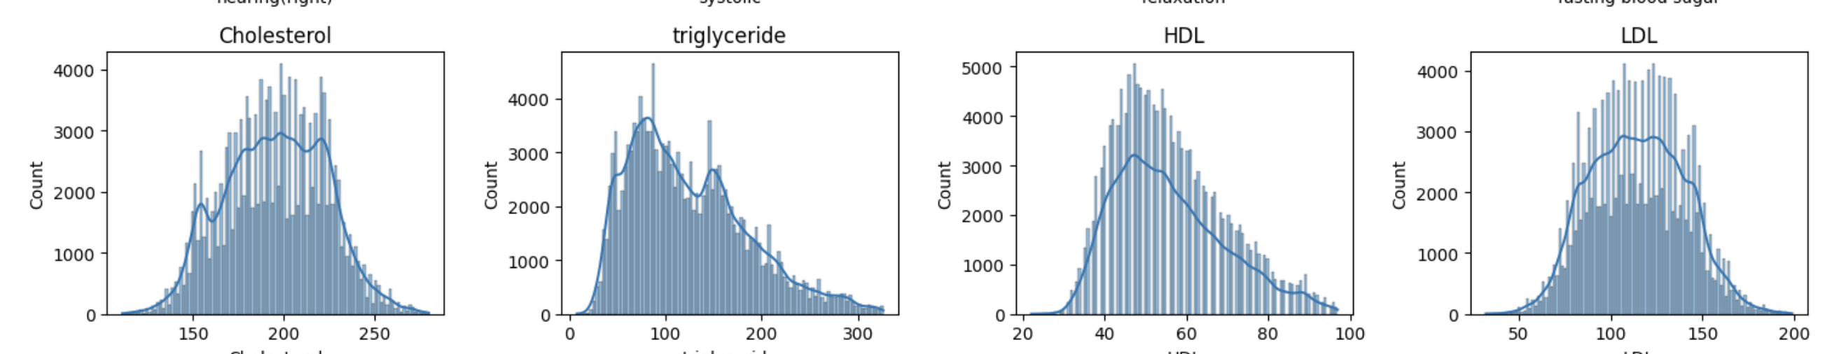
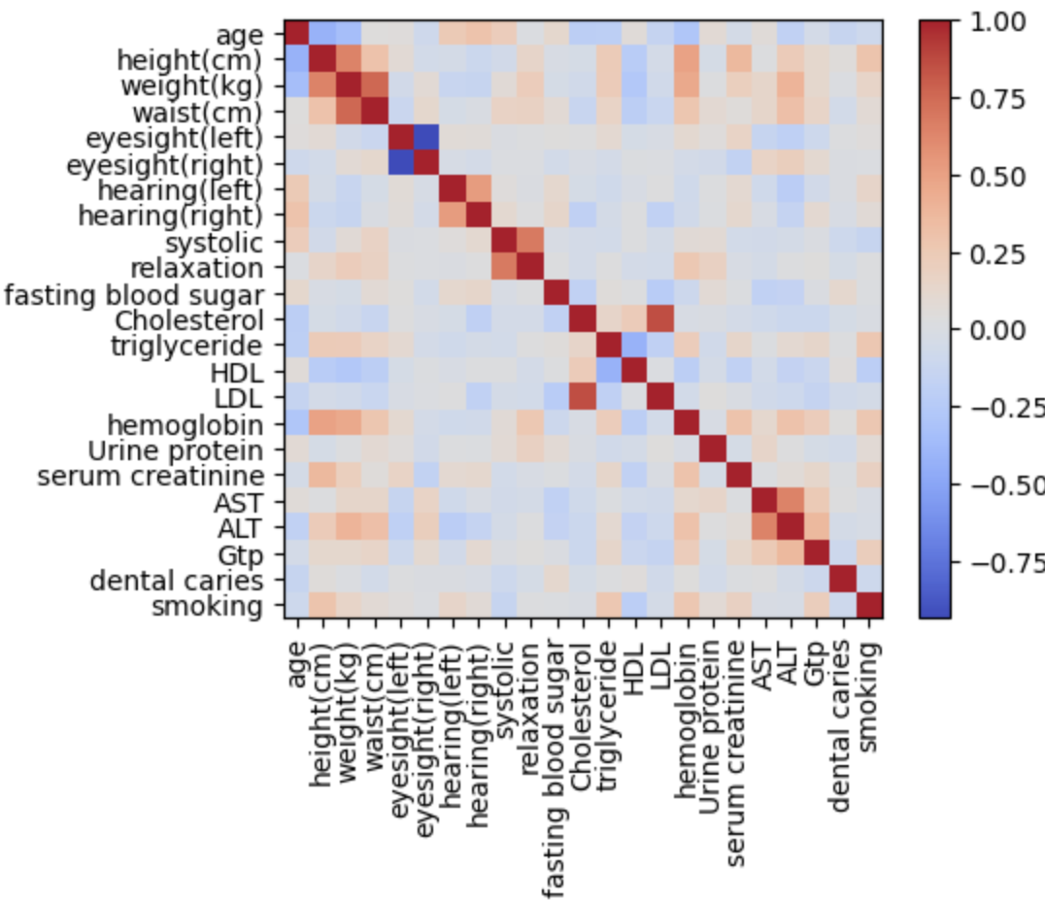
Univariate
Univariate Analysis
Distribution of the target variable
“smoking”
Distribution of each variable
Study of the 9.9 value in eyesight

Slide 10
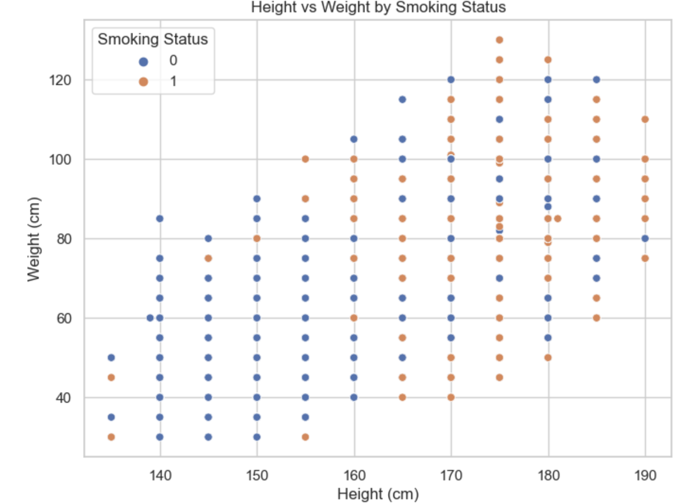
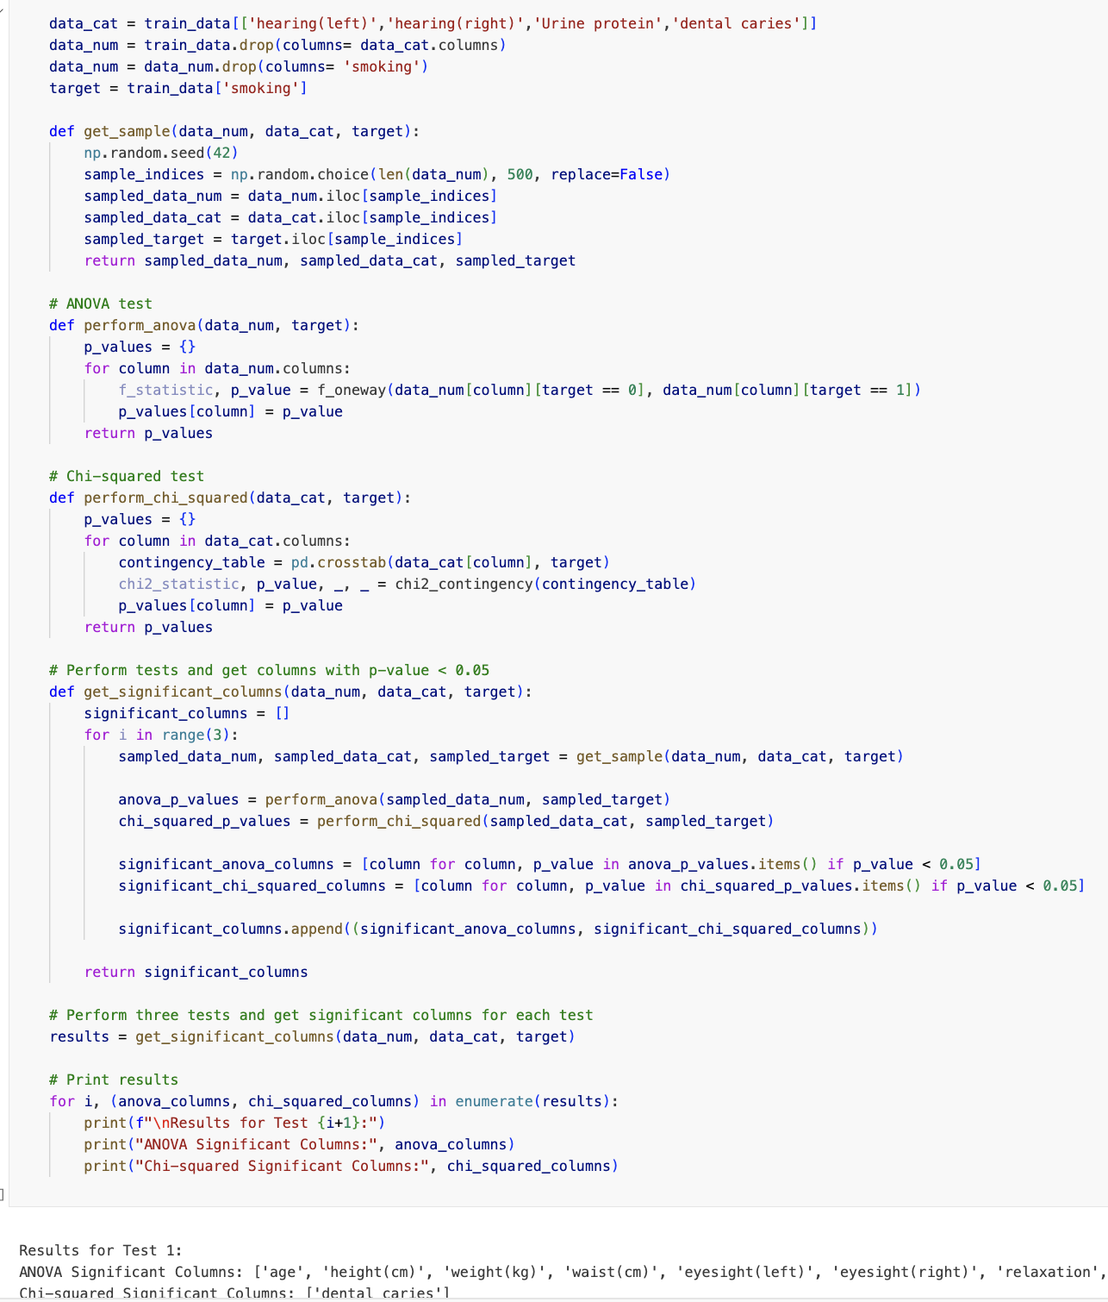
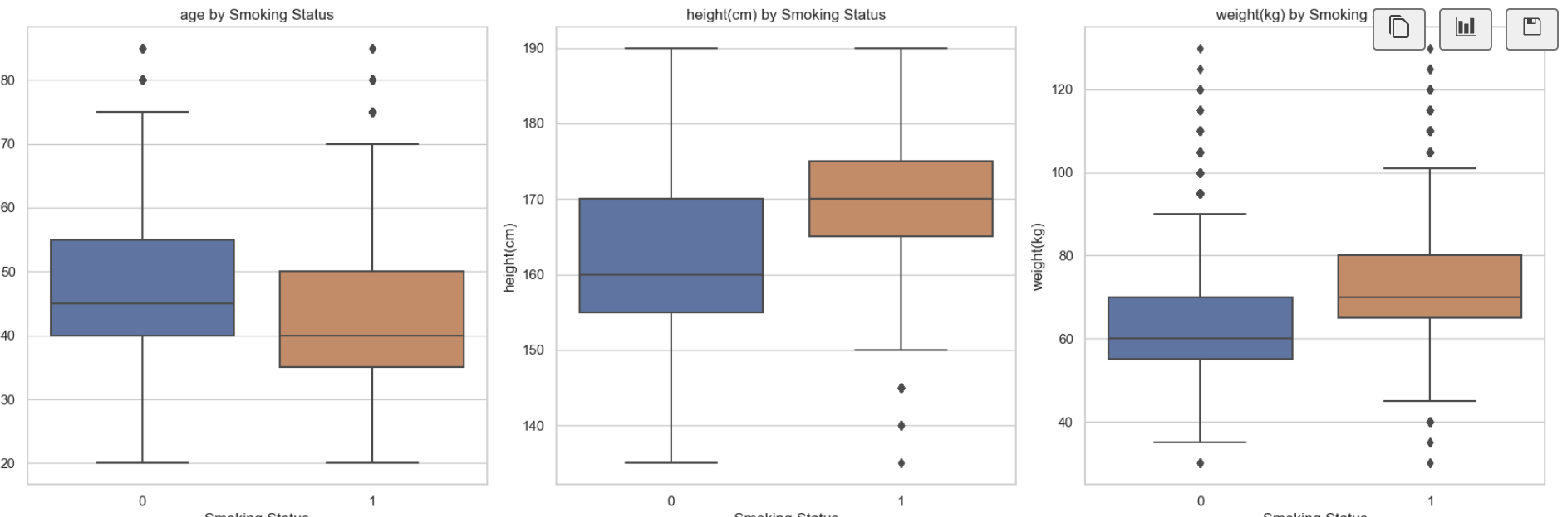
Bivariate
Bivariate Analysis
Box plot: each variable and target variable
Scatter plots:
between variables
if the 25% line of the box is higher than the median value of the other, then there exists an effect on predicting
Height, age, weight, waist, triglyceride, HDL, hemoglobin, serum creatinine, GTP.
Introduce the variable: “gender”
Other relations
ANOVA test & Chi-squared test

Slide 11
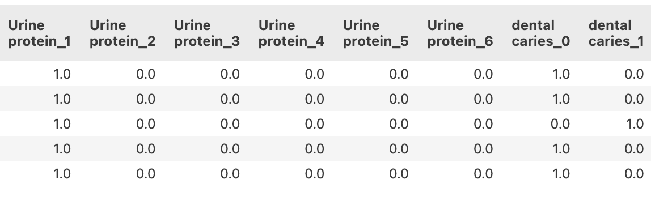
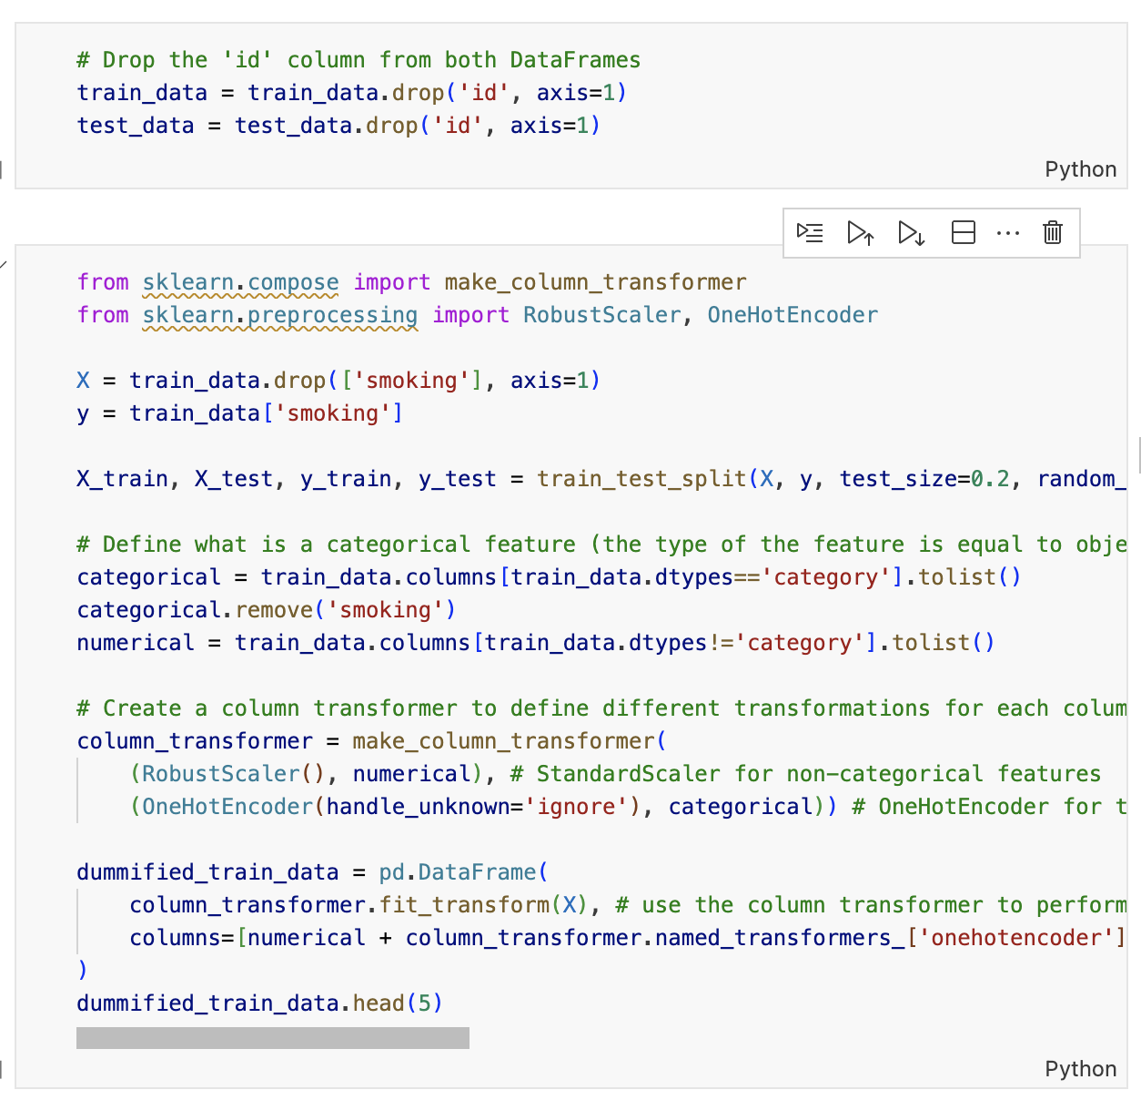
Feature Engineering
Feature engineering
One hot encoding
Scaling
For categorical variables, we did one-hot encoding to prepare the data for model development.
Though random forest is not sensitive to the distance of the points, we scaled the data to prepare it for logistic regression.

Slide 12
Feature Selection

Slide 13
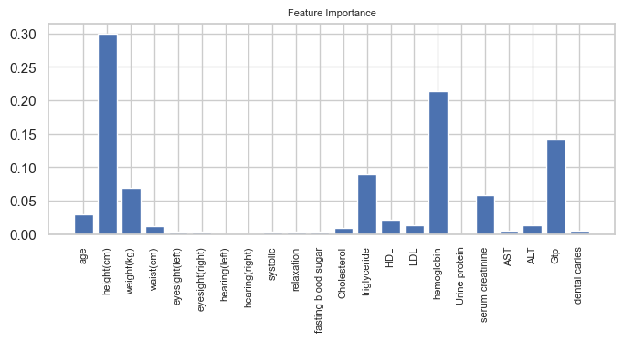
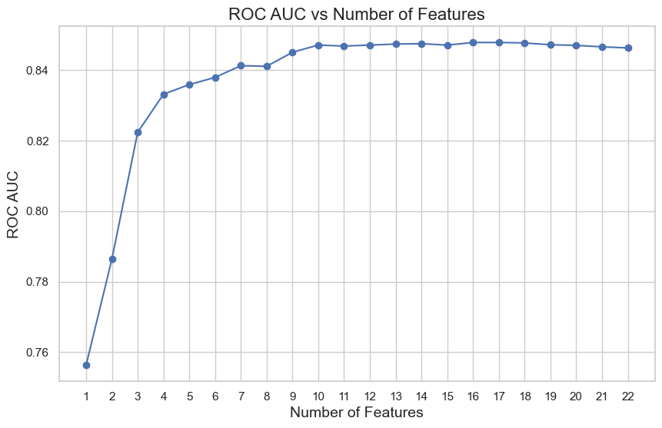
Feature selection using random forest feature importance
1
We trained the model on different subset of features, starting with the most important and adding them one by one, in order of importance.
2
Then we plotted the number of features against the ROC AUC of the accumulated feature subset, and found that the performance plateaus around 10 features

Slide 14
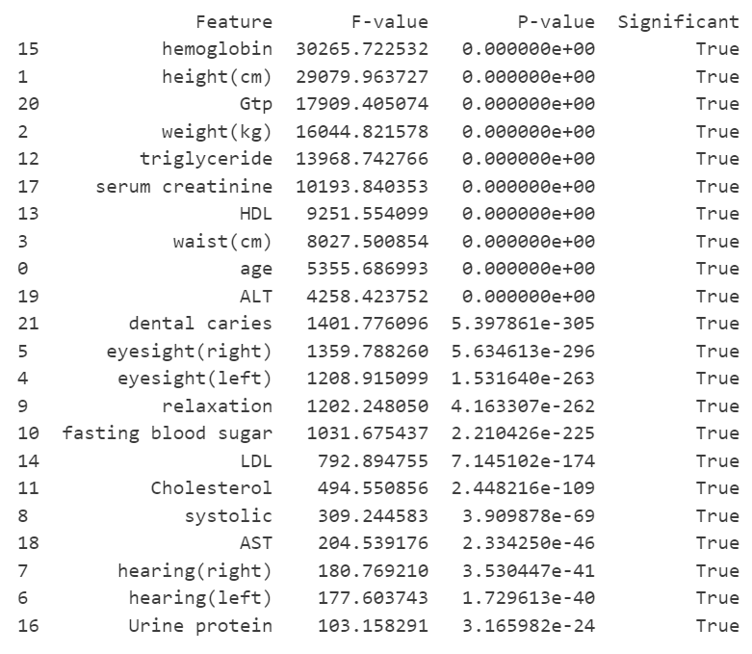
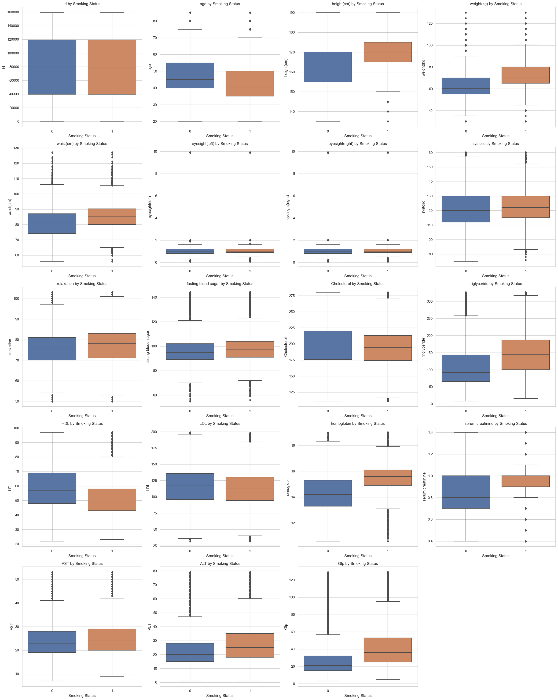
Feature selection using random forest feature importance
Our 10 features had the highest F-scores in the ANOVA test
They also showed clear and distinct differences in their distributions in the different smoking statuses
2
Then we validated the result with the statistical analysis performed during the EDA process.
(kept)
(removed)

Slide 15
Model Development

Slide 16
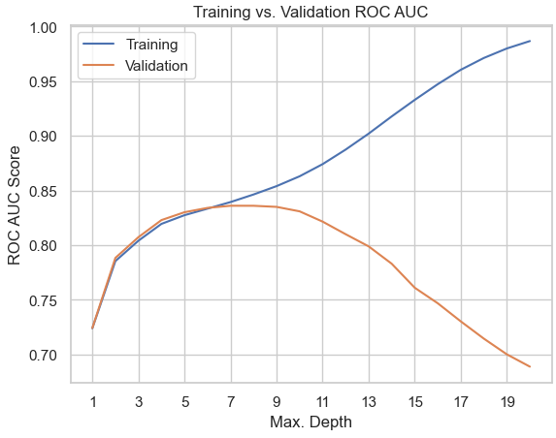
Models Selected:
Logistic Regression
Random Forest
XGBoost
ChatGPT-3.5 + Lab Practice
Hyperparameter Tuning

Slide 17
Model Comparison

Slide 18
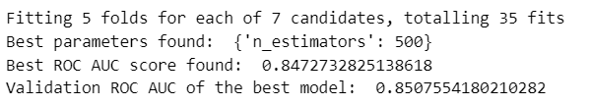
Model Evaluation
Evaluated different machine learning modules
Logistic Regression
Decision Tress
Random Forest
Focused on high predictive power and efficiency ones
Ended using XGBoost algorythm for its perfomance
SCORE USING RANDOM FOREST

Slide 19

Why XGBoost?
We chose it for its ability to handle complex datasets and imbalance
For its scalability and control over training
Benchmarked perdoromance using the ROC AUC score
Outperformed other models in distingushing smoker and non-smoker classes.
SCORE USING XGBOOST

Slide 20
Conclusion

Slide 21
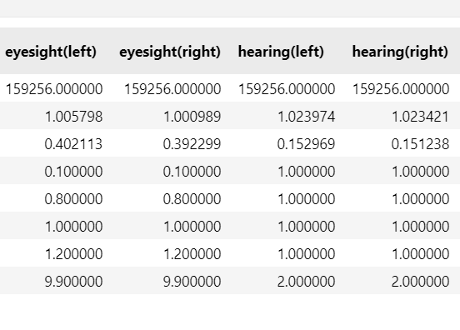
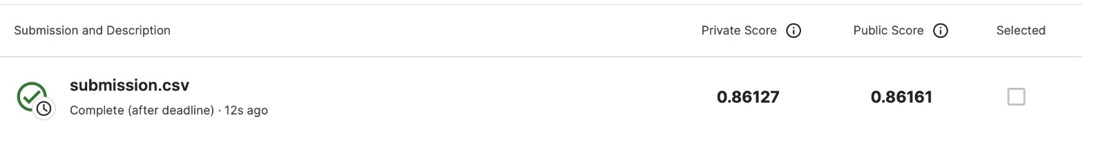
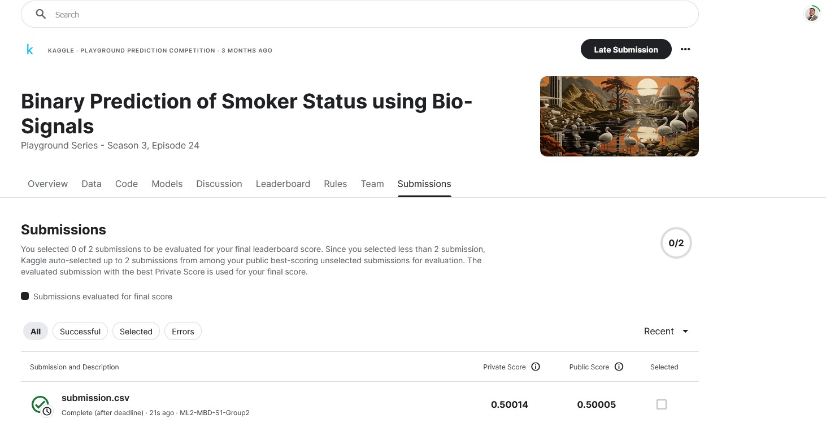
Challenges
Simplify the data
Choose the right model
Handling missing values and outliers to mantain data integrity
Balancing model complexity and performance through feature engineering
Kaggle results did not reflect the train/validation score
Struggled not to overfit our model
Understanding complex features like eyesight numbers and hearing levels

Slide 22
How could we improve?
Explore a wider range of machine learning algorithms for potential improvements
Compare results to unscaled data
Dive deeper into hyperparameter tuning and feature selection
Engage with healthcare professionals to gain insights that could inform feature engineering, model selection, and interpretation of the results

Slide 23
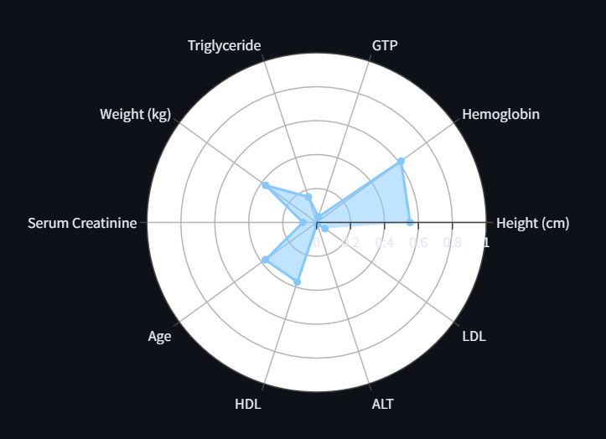


Application of our Model
Offers a tool for early detection of smoking-related health risks in healthcare
Methodologies and insights applicable in behavioral science and public health policy.
By the help of an app we can forecast the probabilities of a person to be smoker or not

